Slide 1
Building a Responsive Navigation Bar with Dropdowns
Create a clean, user-friendly navigation menu using only HTML and CSS.
Prsent by : C. Aathi muthu pandian BCA B

Slide 2
Organizing the Navigation Hierarchy
* The Container: Uses the <nav> semantic tag for SEO and accessibility.
* The List: A <ul> (unordered list) acts as the flex container for menu items.
* The Dropdown Logic: * The "Services" item is given a class of .dropdown.
* Inside it, a <div> with the class .dropdown-content holds the sub-links (Pricing, Marketing, etc.).

Slide 3
Styling and Interaction Logic
Flexbox Layout: display: flex on the <ul> ensures items sit side-by-side.
The Toggle Mechanism:
Default State: .dropdown-content is set to display: none; (hidden).
Active State: .dropdown:hover .dropdown-content switches it to display: block;.
Positioning: position: absolute is used on the dropdown to ensure it floats over page content without pushing other elements down.
Visual Polish: Box-shadows and hover background colors provide depth and feedback.

Slide 4
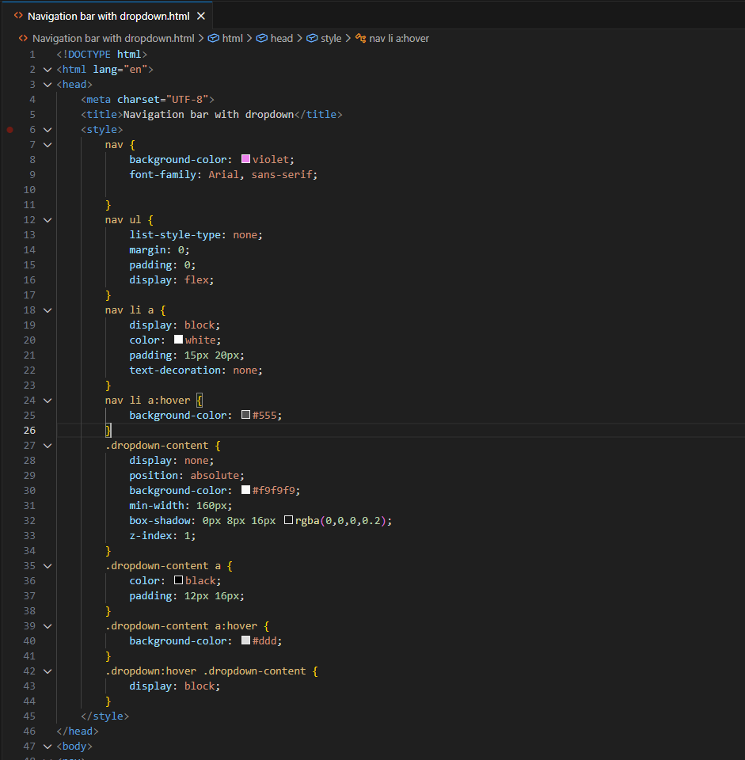
PROGRAM

Slide 5
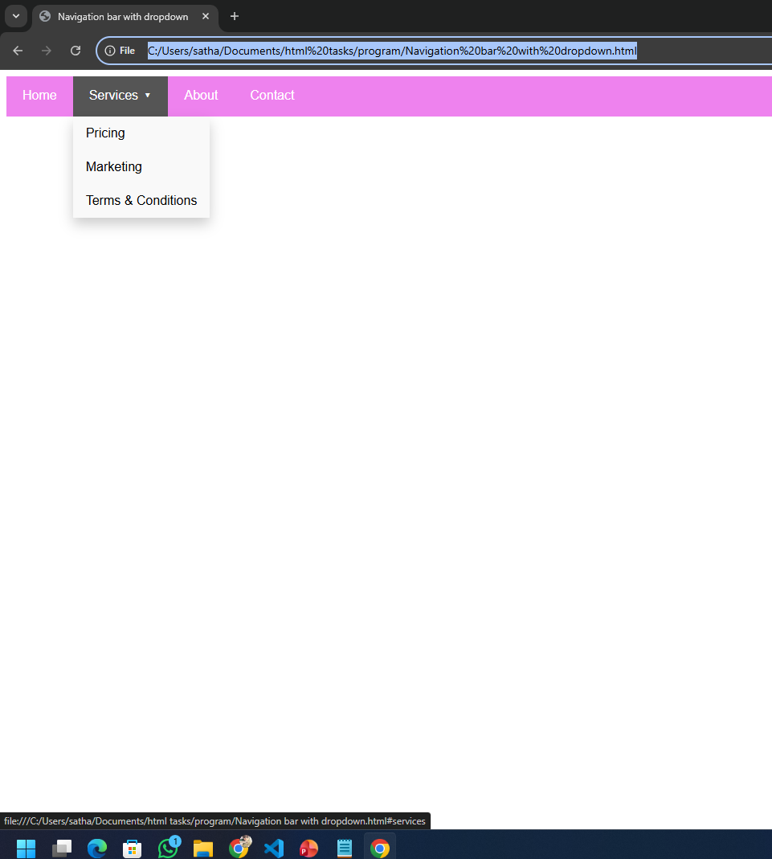
OUT PUT

